Slide 1
PYTHON

Slide 2
MODULE – 4 MACHINE LEARNING

Slide 3
AGENDA
In this module, we will discuss about the following:
Introduction to Machine Learning
Machine Learning - What it is & why it matters
Principles of Machine Learning
Galaxy of Data Science
Machine Learning-Supervised, Unsupervised & Reinforcement
Linear Regression
Classification Model
Anomaly Detection
Data Science V2.0
Data Ready for Data Science V2.0
Answering with Data V2.0
Predict an answer with a simple model V2.0

Slide 4
INTRODUCTION TO MACHINE LEARNING &
PRINCIPLES

Slide 5
INTRODUCTION TO MACHINE LEARNING
Machine Learning is the study of algorithms that,
Improve their performance P
At some task T
With experience E.
Machine learning is an application of artificial intelligence (AI) that provides systems the ability to automatically learn and improve from experience without being explicitly programmed. Machine learning focuses on the development of computer programs that can access data and use it to learn for themselves.

Slide 6
REAL TIME EXAMPLES OF ML
Google:
We are already familiar with how greatly Google is showcasing its ML products in action with Google Assistant and Google Camera to the world. But now it has extended it to Gmail and Google Photos too.
Gmail has now got smart reply feature which will suggest small brief responses to whatever email you’ve received based on the content that is present in the email.
Netflix:
At Netflix, ML has been constantly used to improvise the recommendations and personalization problems. ML has also expanded into various other streams like content promotions, price modeling, content delivery and marketing too.
The entire platform seems to run 80% through the recommendation engine. The neural network keeps a track on user behavior and program content.

Slide 7
REAL TIME EXAMPLES OF ML
Uber:
ML is a fundamental part of this tech giant. From estimating the time to determining how far your cab is from your given location, everything is driven by ML. It uses algorithms to determine all these effectively.
It does these by analyzing the data from the previous trips and putting it in the present situation.
Siri & Cortana:
These voice recognition systems are purely based on ML. Deep neural networks are also a part of these famous voice recognition systems.
They are being trained in a such a way that they can imitate human interactions in exactly the same manner. As the interactions proceed, these apps will learn to understand the skeleton and grammar of the language.

Slide 8
REAL TIME EXAMPLES OF ML
Spotify
Ever played one song and got some five random songs which you would have never discovered by yourself? That’s the beauty of this application named Spotify.
Much like how Netflix uses ML, Spotify uses it the same way. With the weekly releases, it gives you a list of around 30 songs, which you should listen to. It would directly make it as a playlist and send it to users.
All of these songs are picked up by ML algorithms which analyze your activities and matches with your taste from the songs you have listened to in the past.

Slide 9
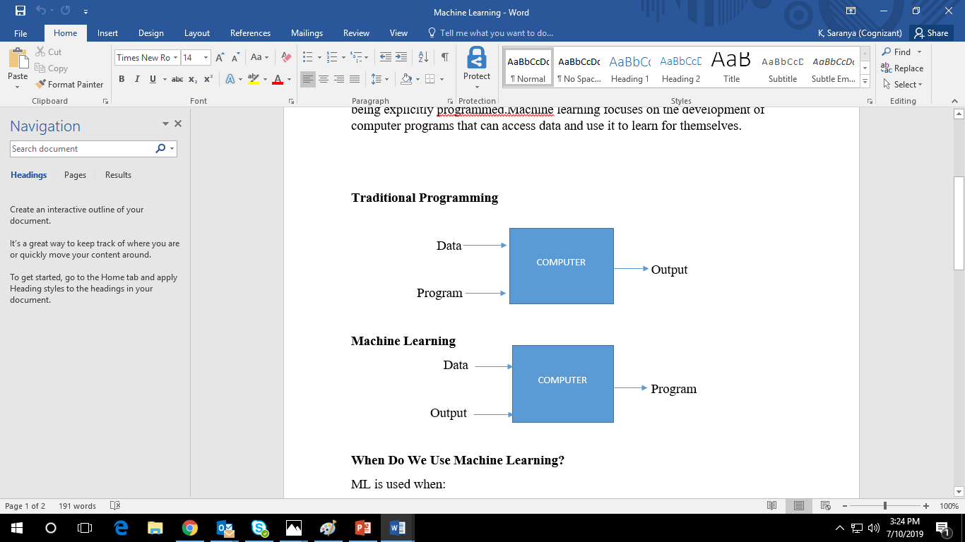
INTRODUCTION TO MACHINE LEARNING

Slide 10
WHAT IT IS & WHY IT MATTERS
Machine learning is a method of data analysis that automates analytical model building.
It is a branch of artificial intelligence based on the idea that systems can learn from data, identify patterns and make decisions with minimal human intervention.
Requirements to create good machine learning systems:
Data preparation capabilities.
Algorithms – basic and advanced.
Automation and iterative processes.
Scalability.
Ensemble modeling.

Slide 11
WHY MACHINE LEARNING MATTERS
The field of machine learning provides tools to automatically make decisions from data in order to achieve some goal or requirement.
The tools and practices of machine learning matter to the world. Four reasons that they matter are:
Automatic: Machine learning methods are automated processes (algorithms) that create algorithms. The methods run on data and produce a model that specifies how to achieve the program’s goal.
Fast: Machine learning methods save you time. The methods can analyze sample input data and deliver a program faster than you could manually write one.

Slide 12
WHY MACHINE LEARNING MATTERS
Accurate: Machine learning methods can do a better job than you. As automated methods, they can run longer on more data than you in order to make more accurate decisions.
Scale: Machine learning methods can provide solutions to problems that you cannot solve. The methods can scale and be interconnected to achieve solutions to problems that previously could not be considered or even conceived.

Slide 13
PRINCIPLES OF MACHINE LEARNING
Occam’s Razor Principle:
This principle states that, given all other things being equal, a shorter explanation for observed data should be favored over a lengthier explanation.
Occam Learning is named after, Occam’s Razor.
Occam learning is a model of algorithmic learning where the objective of the learner is to output a concise representation of received training data.
Sample Bias:
It occurs when the data used to train the algorithm does not accurately represent the problem space that the model will operate in.

Slide 14
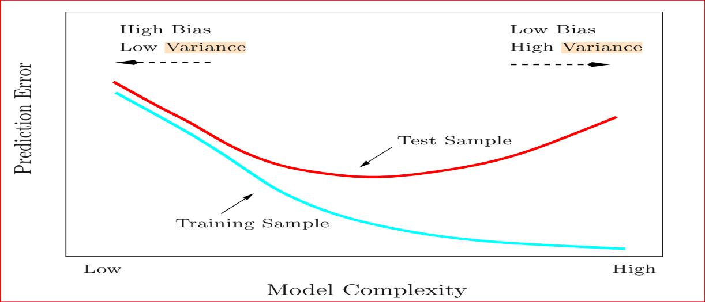
PRINCIPLES OF MACHINE LEARNING
Data scientists use a variety of techniques such as:
samples from populations and validate their representativeness
Identify population characteristics that need to be captured in samples
Analyze a sample’s fit with the population
If the data is sampled in a biased way, learning will produce a similarity biased outcome.

Slide 15
DATA SNOOPING
Data snooping refers to statistical inference that the researcher decides to perform after looking at the data.
Data snooping can be done professionally and ethically, or misleadingly and unethically, or misleadingly out of ignorance.

Slide 16
EXAMPLE OF DATA SNOOPING
A group of researchers plans to compare three dosages of a drug in a clinical trial.
There is no pre-planned intent to compare effects broken down by sex, but the sex of the subjects is recorded.
The researchers have decided to have an overall Type I error rate of 0.05, allowing 0.03 for the pre-planned inferences and 0.02 for any data snooping they might decide to do. The pre-planned comparison shows no statistically significant difference between the three dosages when the data are not broken down by sex.
However, since the researchers have recorded sex of the patients, they decide to look at the outcomes broken down by combination of sex and dosage.

Slide 17
EXAMPLE OF DATA SNOOPING
They notice that the results for women in the high-dosage group look much better than the results for the men in the low dosage group, and perform a hypothesis test to check that out.
In accounting for Type I error, the researchers need to take the number of data-snooping inferences performed as 15, not one. The reason is that they have looked at fifteen comparisons: there are 3×2 = 6 dosage-by-sex combinations, and hence (6×5)/2 = 15 pairs of dosage-by-sex combinations.
Thus the significance level for the post hoc test should not be 0.02. but 0.02/15¹.

Slide 18
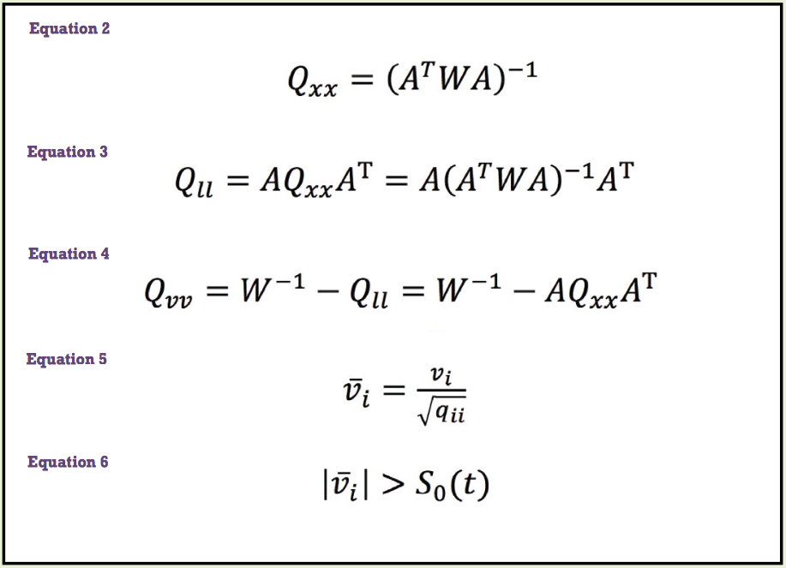
EXAMPLE OF DATA SNOOPING
DIFFERENT EQUATIONS FOR DATA SNOOPING IS AS FOLLOWS:

Slide 19
GALAXY OF DATA SCIENCE,TYPES ML & LINEAR REGRESSION

Slide 20
GALAXY OF DATA SCIENCE
Classification:
Download the data
Process the data
Fit the model
Deploy the model
Consume the model

Slide 21
ML SUPERVISED, UNSUPERVISED & REINFORCEMENT
Machine learning is often split between three main types of learning:
Supervised learning.
Unsupervised learning.
Reinforcement learning.
Knowing the differences between these three types of learning is necessary for any data scientist.

Slide 22
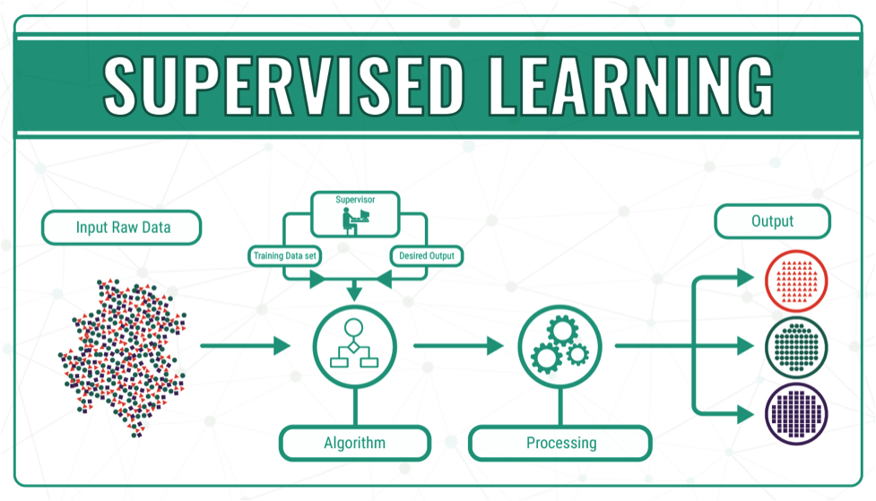
SUPERVISED LEARNING
Supervised learning is the area of Machine Learning where we have a set of independent variables which helps us to analyze the dependent variable and the relation between them. Whatever we want to predict is called as Dependent Variable, while variables that we use to predict are called as Independent Variables.

Slide 23
EXAMPLE FOR SUPERVISED LEARNING
Classification:
Machine is trained to classify something into some class.
classifying whether a patient has disease or not
classifying whether an email is spam or not
Regression:
Machine is trained to predict some value like price, weight or height.
predicting house/property price
predicting stock market price

Slide 24
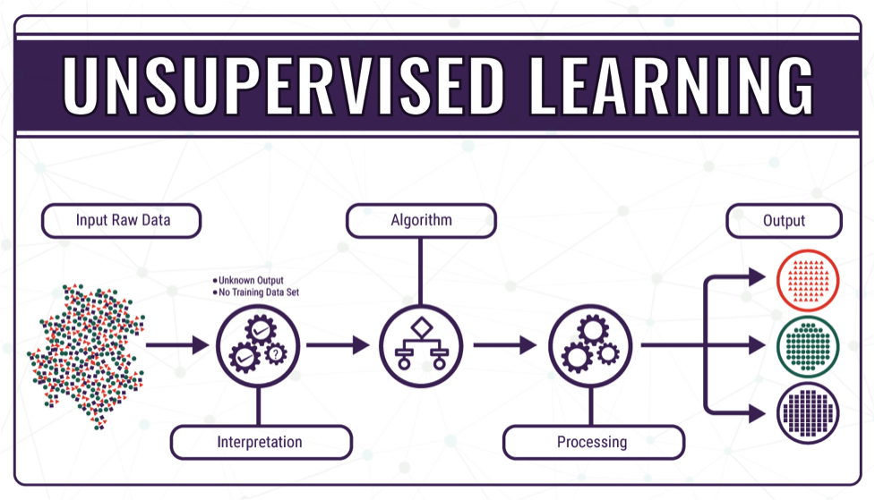
UNSUPERVISED LEARNING
Unsupervised Learning is the area where we don’t have any dependent variable. We just have collection of variables and we try to find out similarity between them and classify them into clusters.

Slide 25
EXAMPLE OF UNSUPERVISED LEARNING
Clustering:
A clustering problem is where you want to discover the inherent groupings in the data.
such as grouping customers by purchasing behavior.
Association:
An association rule learning problem is where you want to discover rules that describe large portions of your data.
such as people that buy X also tend to buy Y.

Slide 26
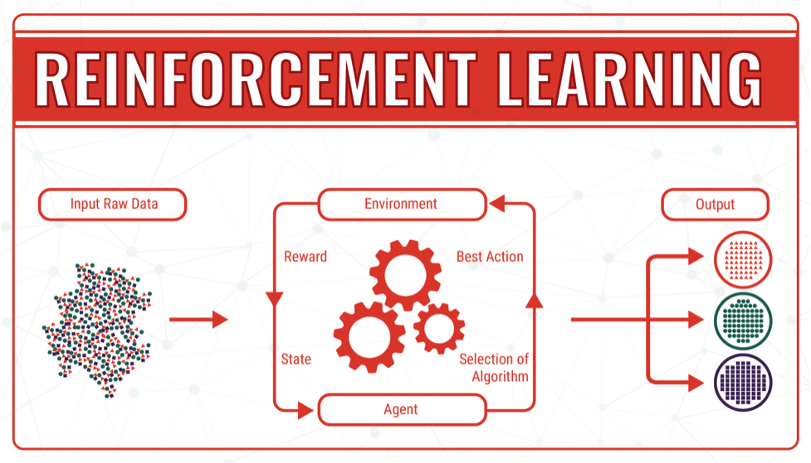
REINFORCEMENT LEARNING
Reinforcement learning is field where machine performs actions and look at the results. Based on the results it learns and then repeats the process again until it understands the entire phenomenon of action and result relation. It allows machines and software agents to automatically determine the ideal behavior within a specific context, in order to maximize its performance.

Slide 27
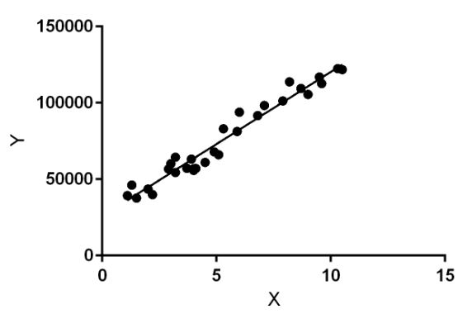
LINEAR REGRESSION
Regression is a method of modelling a target value based on independent predictors.
Regression techniques mostly differ based on the number of independent variables and the type of relationship between the independent and dependent variables.

Slide 28
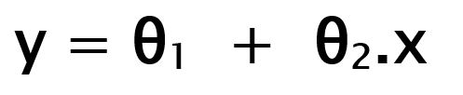
LINEAR REGRESSION
Hypothesis function for Linear Regression :
θ₁: intercept θ₂: coefficient of x
Once we find the best θ₁ and θ₂ values, we get the best fit line.

Slide 29


COST FUNCTION
By achieving the best-fit regression line, the model aims to predict y value such that the error difference between predicted value and true value is minimum.

Slide 30
EXAMPLE OF LINEAR REGRESSION
The table below shows some data from the early days of the Italian clothing company Benetton. Each row in the table shows Benetton’s sales for a year, and the amount spent on advertising in that year.
In this case, our outcome of interest is sales. It is the thing we want to predict. If we use Advertising as the predictor variable, linear regression estimates that Sales = 168 + 23 Advertising.
That is, if advertising expenditure is increased by one Euro, then sales will be expected to increase by 23 million Euro, and if there was no advertising we would expect sales of 168 million Euro.

Slide 31
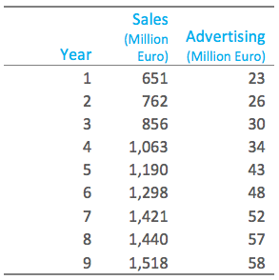
EXAMPLE OF LINEAR REGRESSION

Slide 32
CLASSIFICATION MODEL & ANOMALY DETECTION

Slide 33
CLASSIFICATION MODEL
Classification is a supervised learning approach in which the computer program learns from the data input given to it and then uses this learning to classify new observation.
Some examples of classification problems are: speech recognition, handwriting recognition, bio metric identification, document classification etc.
The types of classification algorithms in Machine Learning:
Linear Classifiers: Logistic Regression, Naive Bayes Classifier
Nearest Neighbor
Support Vector Machines
Decision Trees
Boosted Trees
Random Forest
Neural Networks

Slide 34
NAIVE BAYES CLASSIFIER
GENERATIVE LEARNING MODEL
It is a classification technique based on Bayes’ Theorem with an assumption of independence among predictors.
In simple terms, a Naive Bayes classifier assumes that the presence of a particular feature in a class is unrelated to the presence of any other feature.
Naive Bayes is known to outperform even highly sophisticated classification methods.

Slide 35
NEAREST NEIGHBOR
The k-nearest-neighbors algorithm is a classification algorithm, and it is supervised also it takes a bunch of labelled points and uses them to learn how to label other points.
To label a new point, it looks at the labelled points closest to that new point (those are its nearest neighbors), and has those neighbors vote, so whichever label the most of the neighbors have is the label for the new point (the “k” is the number of neighbors it checks).

Slide 36
LOGISTIC REGRESSION
PREDICTIVE LEARNING MODEL
It is a statistical method for analyzing a data set in which there are one or more independent variables that determine an outcome.
The outcome is measured with a dichotomous variable (in which there are only two possible outcomes).
The goal of logistic regression is to find the best fitting model to describe the relationship between the dichotomous characteristic of interest.

Slide 37
EXAMPLE OF LOGISTIC REGRESSION
Spam Detection
Spam detection is a binary classification problem where we are given an email and we need to classify whether or not it is spam. If the email is spam, we label it 1; if it is not spam, we label it 0. In order to apply Logistic Regression to the spam detection problem, the following features of the email are extracted.
Sender of the email.
Number of typos in the email.
Occurrence of words/phrases like “offer”, “prize”, “free gift”, etc.
The resulting feature vector is then used to train a Logistic classifier which emits a score in the range 0 to 1. If the score is more than 0.5, we label the email as spam. Otherwise, we don’t label it as spam.

Slide 38
DECISION TREES
Decision tree builds classification or regression models in the form of a tree structure.
It breaks down a data set into smaller and smaller subsets while at the same time an associated decision tree is incrementally developed.
The final result is a tree with decision nodes and leaf nodes.

Slide 39
EXAMPLE OF DECISION TREE
For the set X = {a,a,a,b,b,b,b,b}
Total instances: 8
Instances of b: 5
Instances of a: 3
Entropy H(X) = -\left [ \left ( \frac{3}{8} \right )log_{2}\frac{3}{8} + \left ( \frac{5}{8} \right )log_{2}\frac{5}{8} \right ]
= -[0.375 * (-1.415) + 0.625 * (-0.678)]
=-(-0.53-0.424)
= 0.954

Slide 40
RANDOM FOREST
Random forests or random decision forests are an ensemble learning method for classification, regression and other tasks, that operate by constructing a multitude of decision trees at training time and outputting the class that is the mode of the classes (classification) or mean prediction (regression) of the individual trees.
Random decision forests correct for decision trees’ habit of over fitting to their training set.

Slide 41
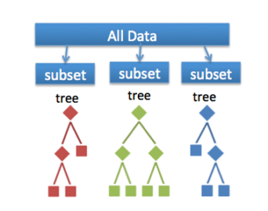
EXAMPLE OF RANDOM FOREST

Slide 42
NEURAL NETWORK
A neural network consists of units (neurons), arranged in layers, which convert an input vector into some output.
Each unit takes an input, applies a (often nonlinear) function to it and then passes the output on to the next layer.

Slide 43
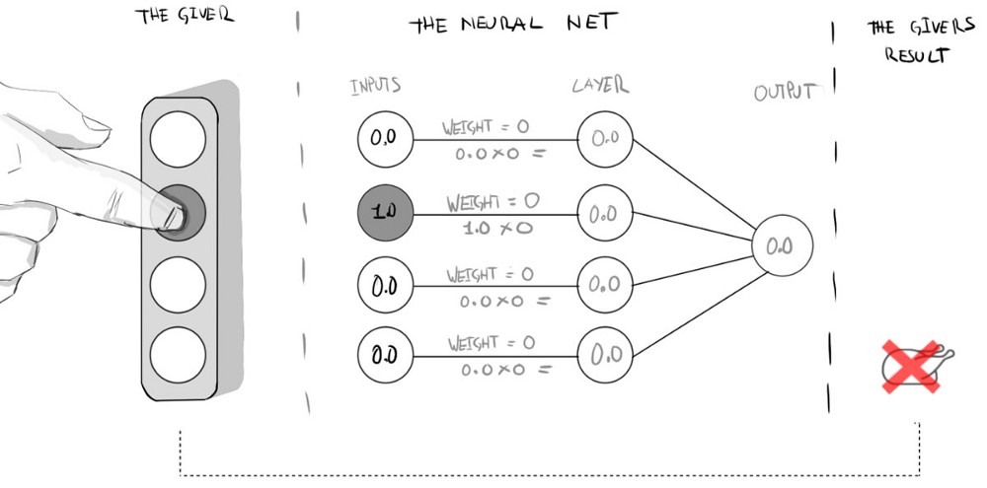
EXAMPLE OF NEURAL NETWORK

Slide 44
BOOSTED TREES
Boosting is one of several classic methods for creating ensemble models, along with bagging, random forests, and so forth.
In Azure Machine Learning Studio, boosted decision trees use an efficient implementation of the MART gradient boosting algorithm. Gradient boosting is a machine learning technique for regression problems.

Slide 45
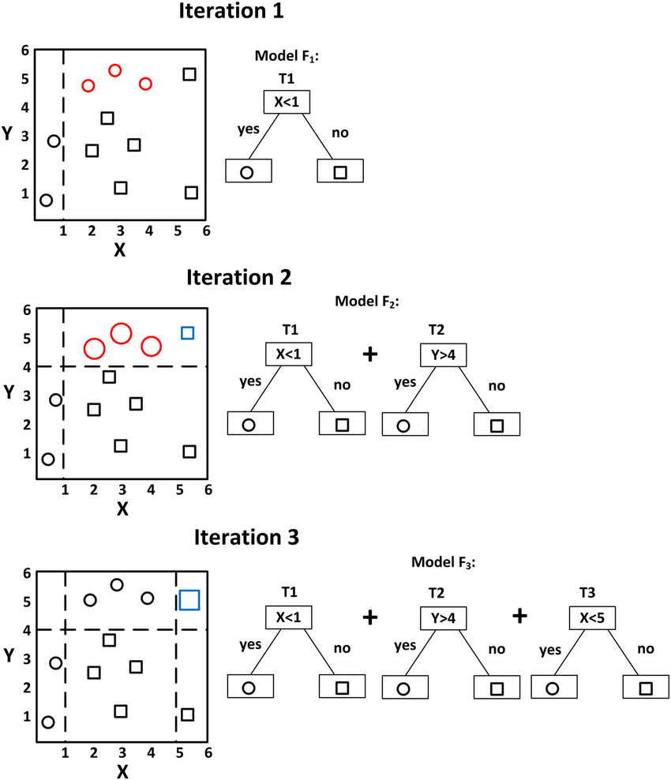
EXAMPLE OF BOOSTED TREE

Slide 46
ANOMALY DETECTION
Anomaly detection(or outlier detection) is the identification of rare items, events or observations which raise suspicions by differing significantly from the majority of the data.
Typically, anomalous data can be connected to some kind of problem or rare event such as e.g. bank fraud, medical problems, structural defects, malfunctioning equipment etc.

Slide 47
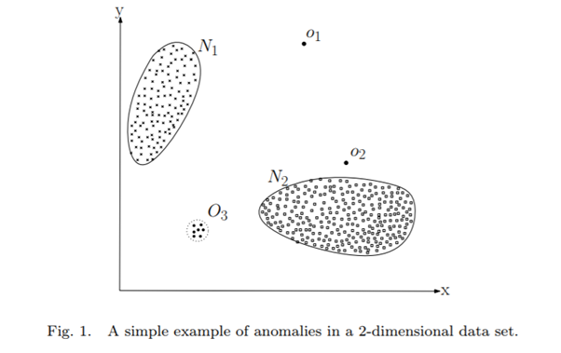
ANOMALY DETECTION
Approach 1: Multivariate statistical analysis
Dimensionality reduction using principal component analysis: PCA
Approach 2: Artificial Neural Network
Auto encoder networks

Slide 48
ANOMALY DETECTION
Supervised Anomaly Detection
K -Nearest Neighbor (k-NN)
Bayesian Network (BN)
Supervised Neural Network (NN)
Decision Tree (DT)
Support Vector Machine (SVM)
Unsupervised Anomaly Detection
Clustering Techniques
Unsupervised Neural Network (UNN) and Niche Clustering (UNC)
K-Means
Fuzzy C-Means (FCM)
Expectation-Maximization Meta Algorithm

Slide 49
DATA SCIENCE,DATA READY,ANSWERING & PREDICTING AN ANSWER WITH A SIMPLE MODEL V2.0

Slide 50
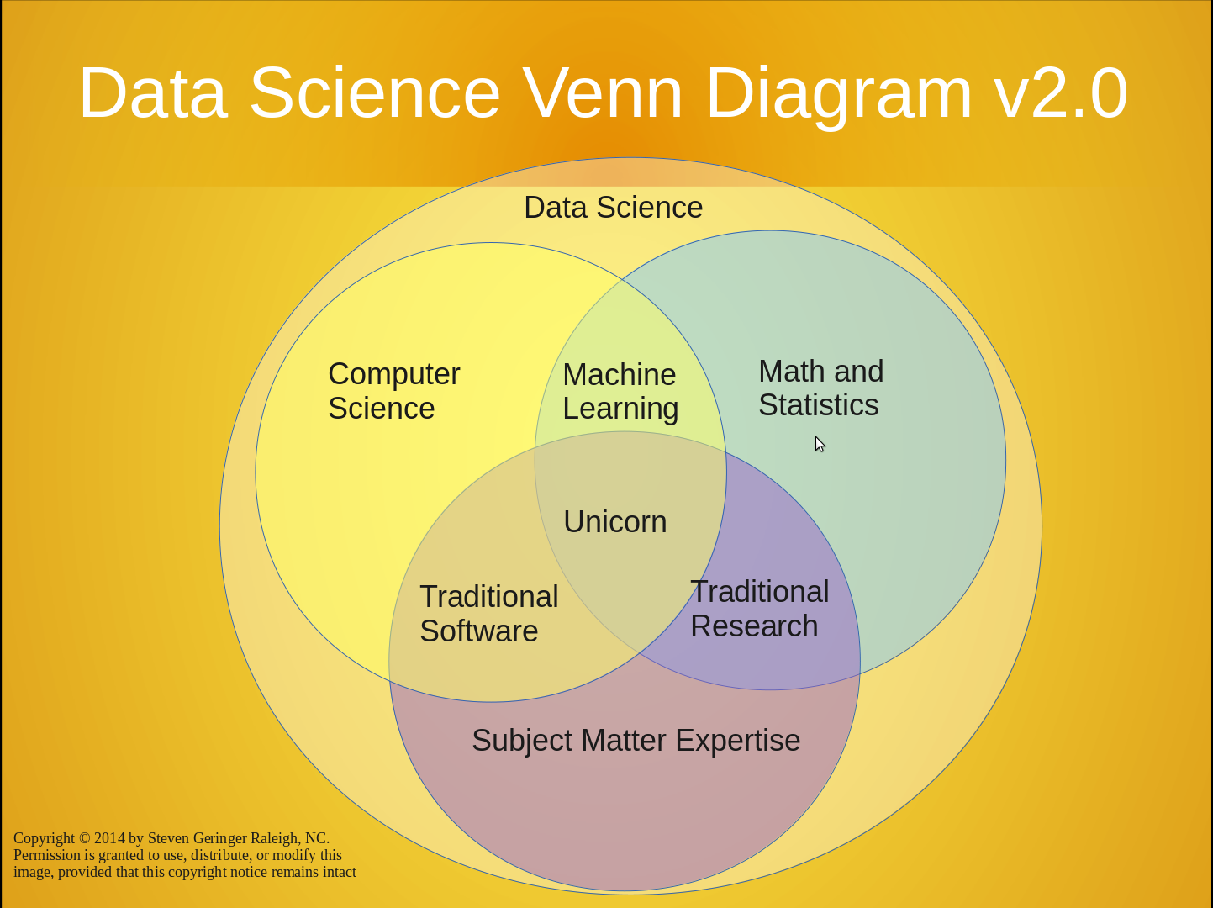
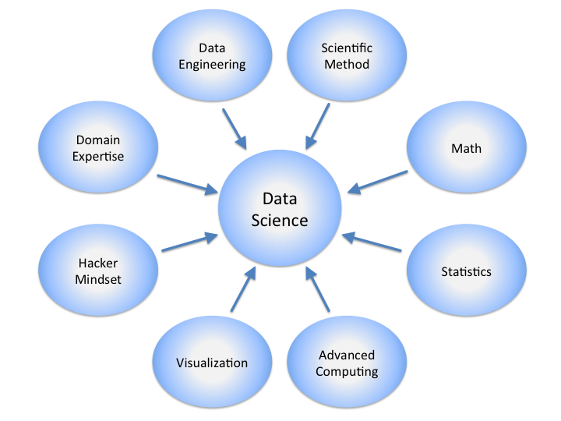
DATA SCIENCE V2.0

Slide 51
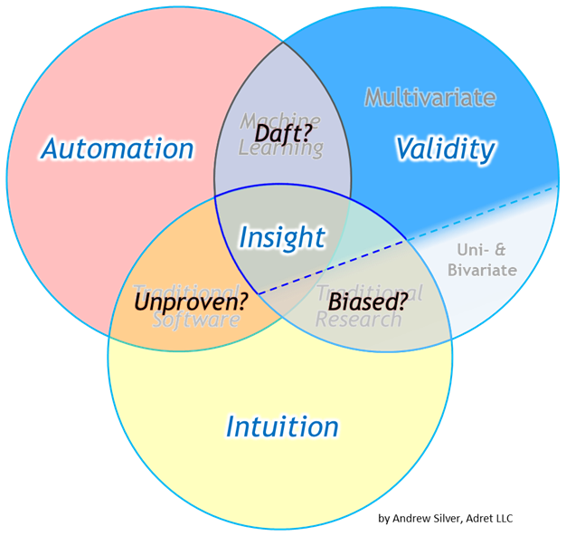
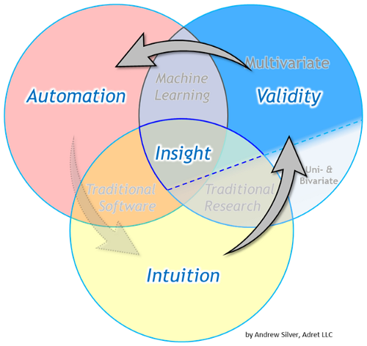
DATA SCIENCE V2.0

Slide 52
DATA READY FOR DATA SCIENCE V2.0
Before getting answer you have to give it some high quality raw materials to work with. It is based on some criteria of data. So, in the case of data science, there are some ingredients that we need to pull together. We need data that is:
Relevant:
Relevant data vs. irrelevant data - evaluate data
Connected:
Connected data vs. disconnected data - data criteria, data ready
Accurate:
Accurate data vs. inaccurate data - data criteria
Enough to work with:
We need to have enough data(Data evaluation)

Slide 53
ANSWERING WITH DATA V2.0
Querying Information from structured and unstructured data has become very important.
Typically, a question answering system consists of several logical blocks:
Data source,
Information retrieval (IR) system,
Machine reading comprehension model (MR model),
One or more additional blocks, such as modules for text pre-processing, answers post processing, checking, and stabilization.

Slide 54
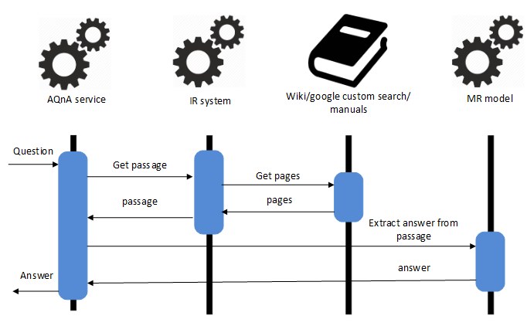
ANSWERING WITH DATA V2.0

Slide 55
ANSWERING WITH DATA V2.0
As you can see in the picture, when the question is transferred to the system, the first step to be done is the search of the texts that can contain the answer to the question.
The sources of such texts can include various web pages, documents stored on a local disc, Wikipedia, etc.
The next step is to select the most relevant texts from all the information that was found. For this purpose, the following approaches could be used: TF-IDF similarity, Jacquard index, Word embedding's, Deep Learning text similarity algorithms.
All of these approaches have pros and cons, different time/memory needs for pre-processing and getting similarity index.

Slide 56
PREDICT AN ANSWER WITH A SIMPLE MODEL V2.0
In this one, we will build a simple model and make a prediction.
A model is a simplified story about our data. I'll show you what I mean.
Collect relevant, accurate, connected, enough data.
Say I want to shop for a diamond. I have a ring that belonged to my grandmother with a setting for a 1.35 carat diamond, and I want to get an idea of how much it will cost. I take a notepad and pen into the jewelry store, and I write down the price of all of the diamonds in the case and how much they weigh in carats. Starting with the first diamond - it's 1.01 carats and $7,366.
Now I go through and do this for all the other diamonds in the store.

Slide 57
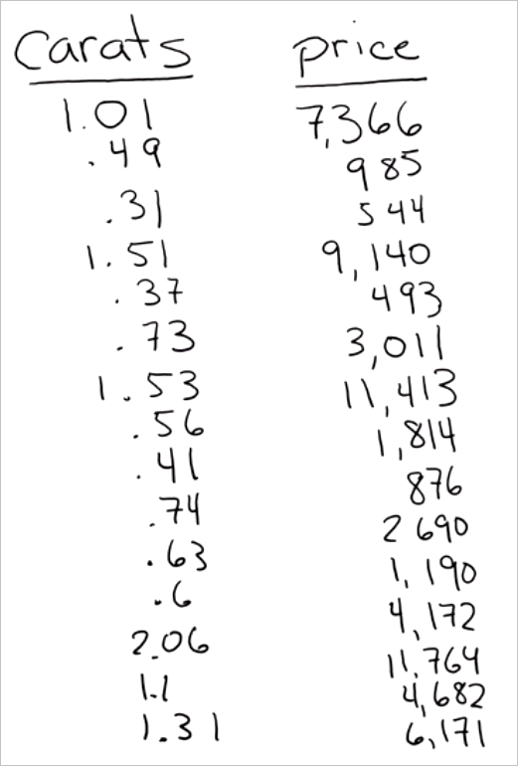
PREDICT AN ANSWER WITH A SIMPLE MODEL V2.0

Slide 58
PREDICT AN ANSWER WITH A SIMPLE MODEL V2.0
Notice that our list has two columns. Each column has a different attribute - weight in carats and price - and each row is a single data point that represents a single diamond.
We've actually created a small data set here - a table. Notice that it meets our criteria for quality:
The data is relevant - weight is definitely related to price
It's accurate - we double-checked the prices that we write down
It's connected - there are no blank spaces in either of these columns and, as we'll see, it's enough data to answer our question

Slide 59
PREDICT AN ANSWER WITH A SIMPLE MODEL V2.0
Ask a sharp question
Now we'll pose our question in a sharp way: "How much will it cost to buy a 1.35 carat diamond?"
Our list doesn't have a 1.35 carat diamond in it, so we'll have to use the rest of our data to get an answer to the question.
Plot the existing data
The first thing we'll do is draw a horizontal number line, called an axis, to chart the weights. The range of the weights is 0 to 2, so we'll draw a line that covers that range and put ticks for each half carat.
Next we'll draw a vertical axis to record the price and connect it to the horizontal weight axis. This will be in units of dollars. Now we have a set of coordinate axes.

Slide 60

Summary
We have discussed about the following topics,
What is ML and its principle?
Galaxy of Data Science
What are Supervised, Unsupervised & Reinforcement?
Linear Regression, Classification Model and Anomaly Detection
Brief description about Data Science V2.0.
Predict an answer with a simple
model V2.0

Slide 61
THANK YOU!!!

